Slide 1
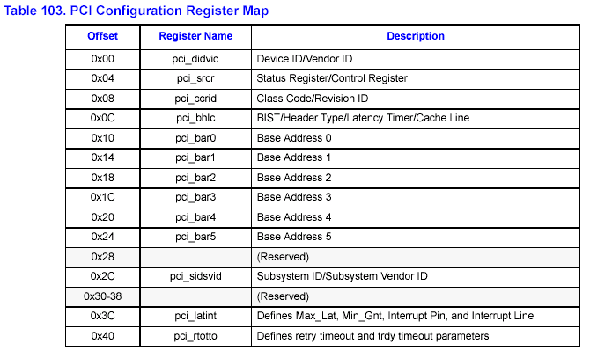
6.1.1 Example: Generating a PCI Configuration Write and Read
*To initialize Base Address Register:
1.write 0x00010010 to PCI Non-Pre-Fetch Access Address
(PCI_NP_AD) register.
Reg no.=10000b = 0x10
1
00000
000
000100
00b
Cycle type = 0x00=>
the same local segment
Bus segment
No.
Dev No.
Reg No.
Cycle type
Func No.

Slide 2
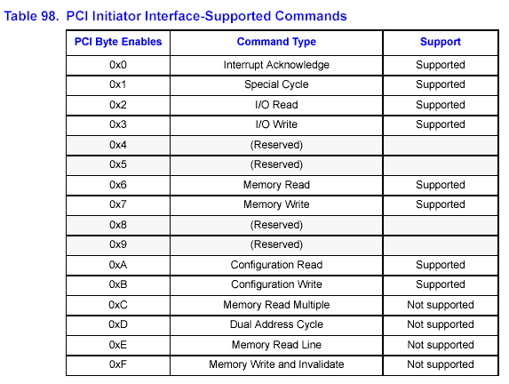
2.write 0x0000000B to PCI Non-Pre-fetch Access Command/Byte
Enables (PCI_NP_CBE) register. (Configuration Write)

Slide 3
3.write 0xFFFFFFFF to PCI Non-Pre-fetch Access Write Data
(PCI_NP_WDATA) register.
As per PCI 2.2 spec--6.2.5.1: Power-up software can determine how
much address space the device requires by writing a value of all 1’s
(0xFFFFFFFF) to the register and then reading the value back.The
device will return 0’s in all don’t-care address bits,effectively
specifying the address space required.
Ex., A PCI device requires a 64-Mbyte address space for Base Address
Register 0 used for memory transactions, then only bits(31:26)
would be set to ‘1’.
0xFC00 0000 = 1111 1100 0000 0000 0000 0000 0000 0000b

Slide 4
4.write 0x00010010 to PCI Non-Pre-Fetch Access Address
(PCI_NP_AD) register.
5.write 0x0000000A to PCI Non-Pre-fetch Access Command/Byte
Enables (PCI_NP_CBE) register.(Configuration Read)

Slide 5
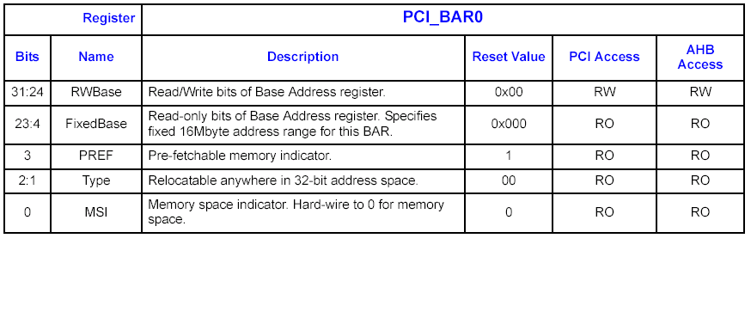
6. Read PCI Non-Pre-fetch Access Read Data(PCI_NP_RDATA)
Register. Ex., Return value= 0xFC000008 => request 64Mbytes
with memory space,32-bit, prefetchable.
0xFC00 0000 = 1111 1100 0000 0000 0000 0000 0000 1000b
MSI: 0 = memory space, 1 = I/O space
Type: 00 = locate anywhere in 32-bit address space
10 = locate anywhere in 64-bit address space
PREF: 1 = prefetchable

Slide 6
7. If we want the address space to reside at PCI location 0xA0000000,
then a Configuration Write of 0xA0000000 will be written to Base
Address Register 0 of the external PCI device. No other PCI
assignment can be placed between PCI addresses 0xA0000000
and 0xA3FFFFFF.

Slide 7
1.
write 0x00010010
To initialize Base
Address Register 0
PCI_NP_AD register
2.
write 0x0000000B
Configuration Write
PCI_NP_CBE register
write 0xFFFFFFFF
In order to get the
address space required
PCI_NP_WDATA register
3.
4.
write 0x00010010
To initialize Base
Address Register 0
PCI_NP_AD register
5.
write 0x0000000A
Configuration Read
PCI_NP_CBE register

Slide 8
Read from
Ex., Return value=
0xFC000008
=> request 64Mbytes
with memory
space,32-bit, prefetchable
PCI_NP_RDATA register
6.
7.
write 0x00010010
To initialize Base
Address Register 0
PCI_NP_AD register
8.
write 0x0000000B
Configuration Write
PCI_NP_CBE register
write 0xA0000000
External PCI device’s
address space reside at
PCI location 0xA0000000
PCI_NP_WDATA register
9.

